Slide 1
The Strange Case of Dr Jekyll and Mr Hyde: features and themes

Slide 2
The Strange Case of Dr Jekyll and Mr Hyde (1886)
In Dr Jekyll and Mr Hyde, Dr Jekyll is a well-respected and benevolent scientist who secretly has a dark, immoral side to his personality. This side to his personality is not active, however, he decides to activate it through his experiments. He manages to create a drug which enabled him to project himself into a repulsive person -Mr Hyde - who commits cruel acts of violence against others.

Slide 3
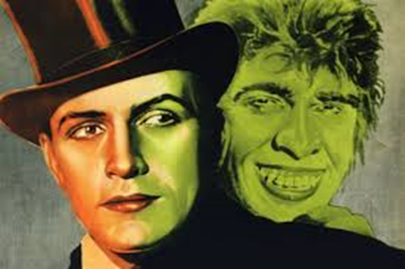
THEMES
Through this change in Jekyll's character, Stevenson shows the duality in human nature - the idea that everyone is capable of good and evil deeds
Dr Jekyll is perceived as a kind, educated and popular scientist. He is the embodiment of 'goodness.‘
Mr Hyde is perceived as a cruel, ugly, vicious man who commits wild acts of violence against innocent people. He is the embodiment of 'evilness'.

Slide 4
Keys to interpretation (1)
A parallelism with the Victorian society: APPEARANCES and REPUTATION
The decorum and the respectability of the Victorian society hides often distasteful and unpleasant underside (Victorian Compromise)→ the apparent respectability of Dr Jekyll hides an hidden underside.
Dr Jekyll wants to keep up a well-respected façade, even though he has a lot of sinful tendencies

Slide 5
Keys to interpretation (2)
The STRICT MORALITY of the Voctorian society and his consequences
The severe Victorian morality leads many people to suppress their desires and feelings living a frustrated and hypocrite life.
As a member of the upper class, Dr Jekyll is expected to behave properly and as a gentleman; this is why he represses his instinctual side, whose hidden presence therefore grows more oppressive until to burst and get out of the control.

Slide 6
Symbolism (1)
Dr Jekyll and Mr Hyde is a symbolical story, a metaphor of the moral dichotomy of the human soul. The co-existence of good and evil in man is in fact emphasized through many symbolical devices:
Names: the names of the protagonist/s can be interpreted in this way: Jekyll may stand for the Anglo-French words «je kill», while the pronunciation of Hyde suggests something secret, hidden within something else;
The door- Jekyll’s house has two doors, a front door opening on a respectable square and a degraded back door full of cracks. This latter looks like a kind of opening on the unconscious, on hell, on what is different from the normally accepted social values;

Slide 7
Symbolism (2)
The house- while the front of Jekyll’s house is typically Victorian and respectable, the back is a sinister, dirty building, without windows, arousing disgust and horror. The house itself is half Jekyll and half Hyde;
The weather- the fog, the cloudy sky, the night, persistent throughout the book, all convey a sense of real and symbolical darkness.

