Slide 1
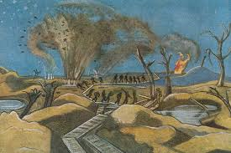
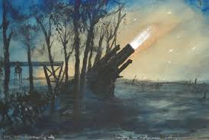
The 20th Century
Paul Nash (1889-1946)

Slide 2
Edward VII’s reign and the social reforms
After the death of Victoria in 1901, Edward VII became king. During his reign (1901-1910) the Liberals gained supremacy in the election and important social reforms were passed which put the foundations of a Welfare State:
The Education Act (1902), which paved the way to a a system of secondary school education;
The Old Age Pensions Act (1908), which granted pensions to people over 70;
National Insurance Act (1911) which made free medical treatment available to insured workers
These changes involved also increasing attention to the status of women. The Women’s Social and Political Union was founded in 1903 (in 1918 women over 30 were finally granted the right to vote; in 1928, suffrage was extended to women over 21)

Slide 3
George V (1910-1936): the war and the post war period
The years before the outbreak of World War I saw the culmination of the process that had characterised British society during the Victorian Age such as:
The falling of prices and the doubling of wages of the lower class;
Widespread industrialization and new technical innovations;
The growth of population and urban spaces;
The extension of transport network.
In July 1914 World War I broke out. France, Russia and Britain sided to Serbia against Austria and Germany. After the declaration of war George changed his German name of Hannover for the English name Windsor.

Slide 4
The Irish Question (1)
The majority of the Irish population was Catholic and they generally supported the idea of a more independent Parliament in Dublin, but the majority Protestant population of Ulster (Northern Ireland) wanted to stay under British rule.
This tension beween the Unionists and the Republicans broke out on Easter Monday in 1916, when a group of Republicans organised a revolt in Dublin. This revolt was violently suppressed. As a result, support for Irish independence grew among the general population, and the Easter Rising became a symbol for Irish resistance to British rule.

Slide 5
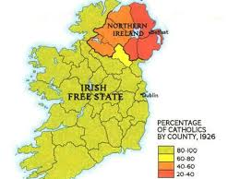
The Irish Question (2)
After the war, Ireland took importance steps towards independence. In 1918 the Sinn Fein party proclaimed an Irish Republic;
In 1919 the IRA (Irish Republic Army) was created and a civil war began.
The war ended in 1921 and in 1922 the Irish Free State was born, excluding Ulster, which remained part of the United Kingdom

Slide 6
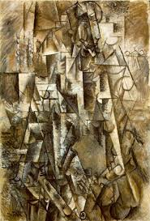
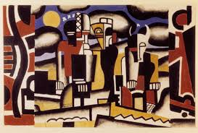
Modernism (1900- 1930s)

Slide 7
Modernism
Modernism is a term which is not only associated with literature, but also with the great changes which affected all the arts- music, visual arts, cinema- in Europe and America starting after 1910 and flourishing in the 1920s and 1930s
Background:
The violence and destruction of World War I cause a sense of instability, and traditional values of patriotism, identity and faith started to fade → this leave people with a sense of distrust and without a clear reference point. The artist feels alone and misunderstood and a new interest in the inner self grows

Slide 8
Modernism: features
A radical break with the literary tradition of the 19 th century; they try new ways of expression through experimentation in form and style;
Modernist work is typically fragmentary and relative, favouring subjective perceptions of reality→ the truth is fragmentary and changeble
Urgency to represent the variety of modern urban life. One way of trying to create order out of the chaos of the modern world was the recourse to primitive myths

Slide 9
Freud’s theory of the unconscious
According to Freud the development of our personality is greatly affected by the unconscious, the hidden part of ourselves. Man has no control of this side and his reason could play no part in dominating or influencing it . To analyse the unconscious Feud gave great importance to the interpretation of dreams and to the free association of thoughts, a theory according to which each individual associated his ideas freely, guided by the personal experiences, desires and impulses buried in the unconscious. → Our perception of reality is therefore fundamentally subjective.
Some writers were fascinated by his methods of investigating human personality and tried to apply them to the analysis of the workings of the mind of their characters (James Joyce, Virginia Woolf).

Slide 10
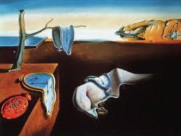
“When you sit with a nice girl for two hours you think it's only a minute, but when you sit on a hot stove for a minute you think it's two hours. That's relativity” Einstein
Dalì- The persistence of the memory

Slide 11
Bergson’ s philosophy of «duration» and the relativity theory by Einstein
Bergson distinguished between the mathematical time of science and the time of the mind, which is lived in a personal way and changes from one person to another, or from one situation to another. Bergson called this second time «duration». Duration is the way we experience the world moment by moment.
The theories of Bergson contributed to question the traditional idea of linear narrative in modernist writers.
In the same period Albert Einstein was elaborating the theory of relativity. He demostrated that even time is relative, because it is depedent on the viewpoint and the circumstances. With Einstein’s theory the idea of an objective reality was put in doubt.

Slide 12
Modernism and the novel
From a stylistic point of view, Modernist novels broke with the tradition:
The omniscient narrator as moral and spiritual guide disappeared and was replaced by the direct or indirect presentation of character’s thoughts, feelings and memories;
The chronological presentation of a story with its orderly sequence of events in a well-made plot disappeared and is replaced by a new concept of duration that reproduced the inner reality of the characters

Slide 13
Stream of consciousness techniques
The psychologist William James coined the expression «Stream of consciousness» to indicate the continuous flow of thoughts and sensations that characterises the human mind.
This unspoken activity of the mind was used in two narrative techniques:
Direct interior monologue (or free direct speech), which refers to the direct presentation of a character’s stream of consciousness without the guiding presence of an author or narrator;
Indirect interior monologue (or free indirect speech), which refers to the indirect presentation of character’s thoughts filtered through the voice of anonymous narrator

